Slide 1
H&W WELDERS FC
H&W WELDERS FC
PRESENTATION BY: PAUL KEE
HEAD COACH
U.E.F.A Pro Licence holder
L.M.A. Management Diploma

Slide 2
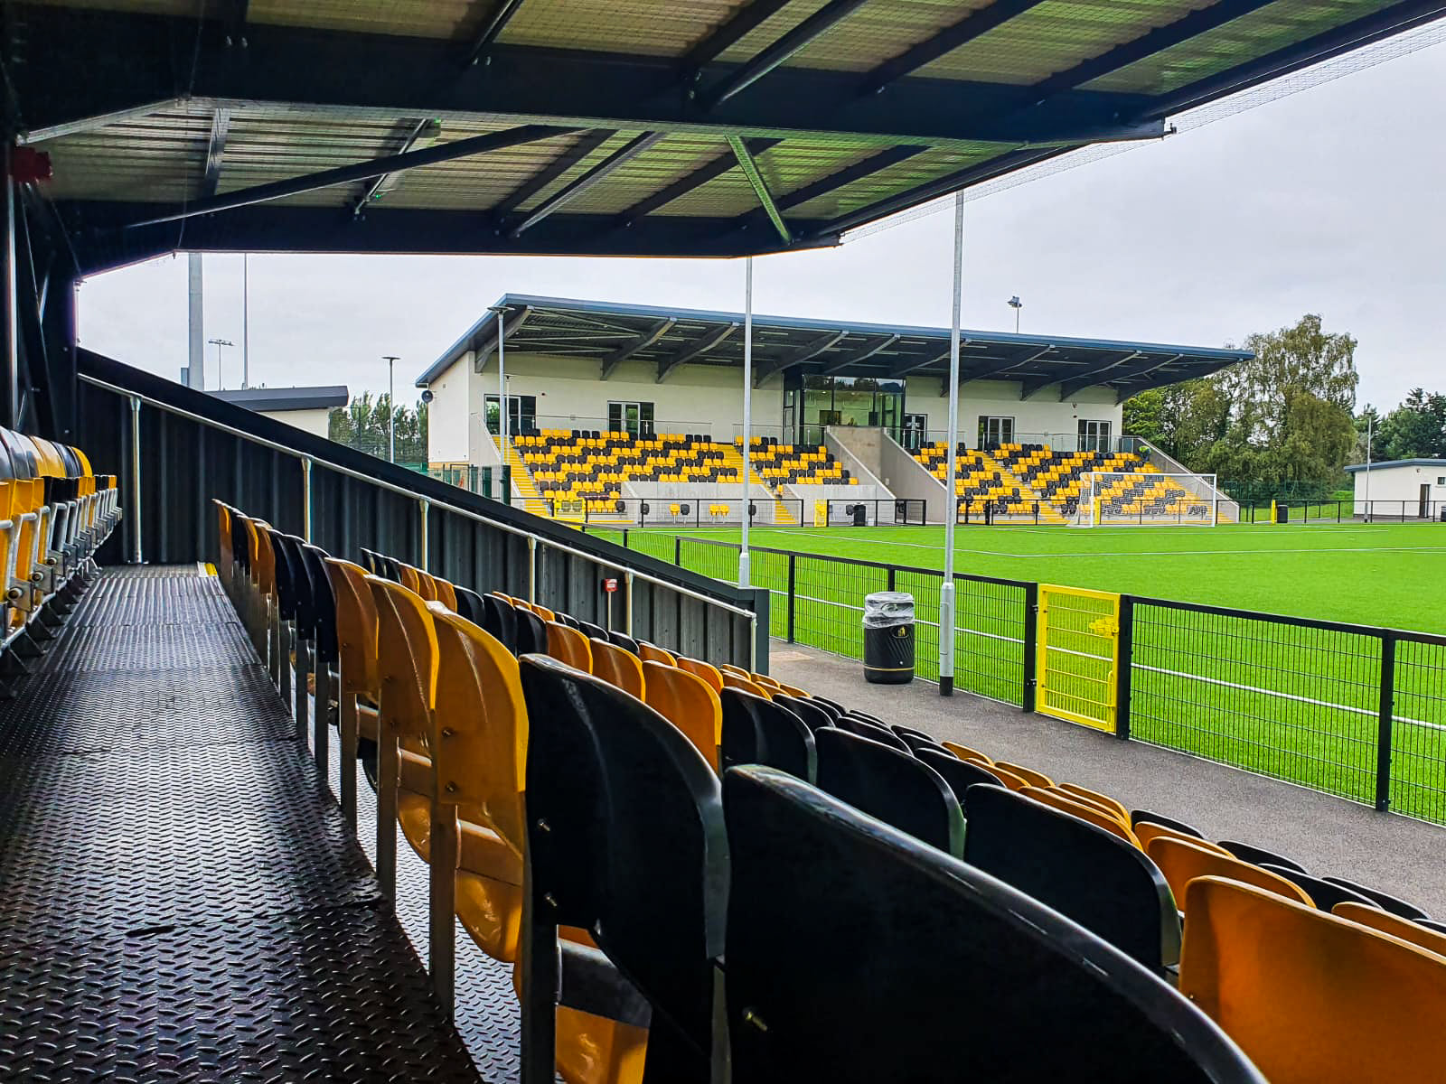
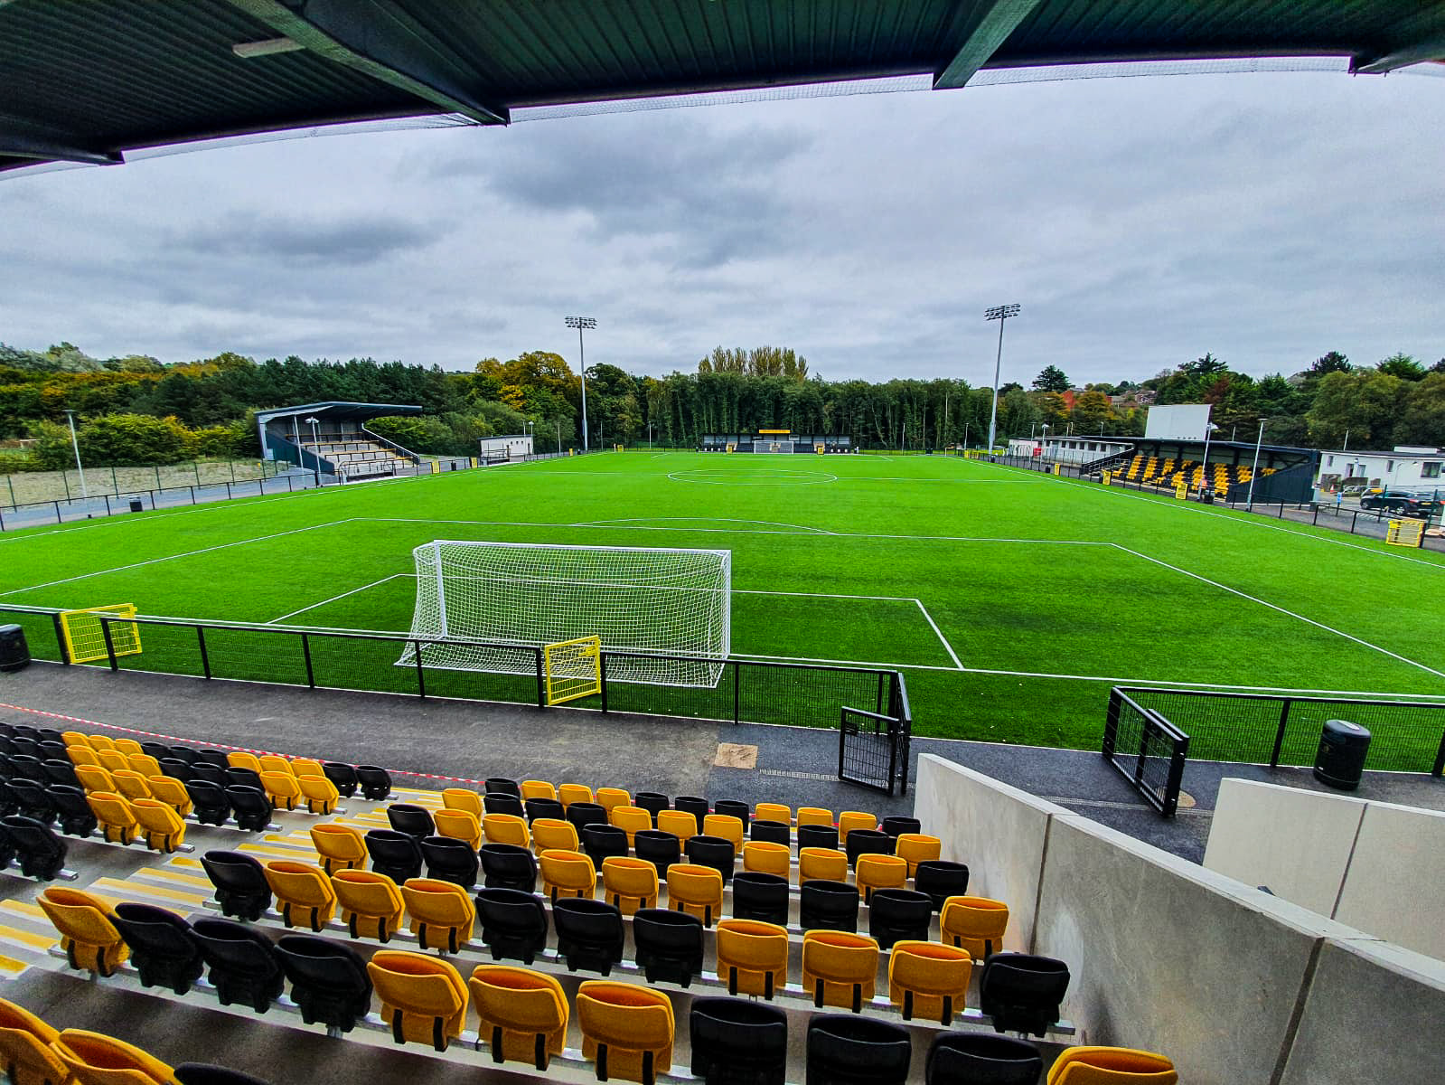
GENERAL DETAILS
Development Programme 4 years +
Community and Academy
Academy partner (Ridgeway Rovers)
Not for profit organisation
Local cross community club
Based at Blanchflower Stadium
Project Administrator Ray Alexander

Slide 3
H&W WELDERS PARTNERSHIPS 2023-24

Slide 4
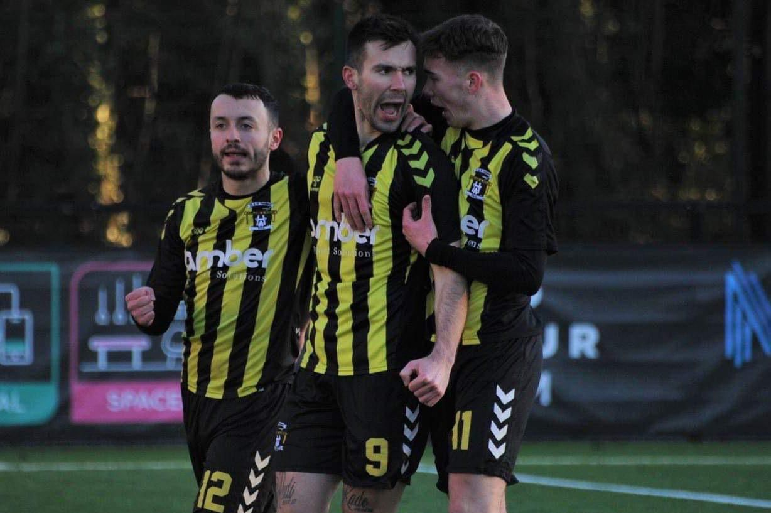
MENU FOR SUCCESS
Education Programme
UEFA Pro Licence Staff
UEFA Qualified staff
Cross Community
4-14 age (Community)
U16/U18 U21 squads (Academy)
1st Team squad (18+ Adults)
After School
Football 4 All Development Centres
Mainland UK contacts

Slide 5
So, what do we really mean when we say, ‘community programme’?
Football brings people together as a family.
It promotes good behaviors for a better society, just like many of the other sports played in our communities.
Sportsmanship is about teamwork, discipline and supporting each other, these behaviors are the key to a good society.
The Community programme acts as the main feeder for the Ridgeway Rovers programme
H&W Welders are in Partnership with Rovers…

Slide 6
Community Benefits
Social development/ mixing with children both all sections of our community
FFL football for life, development of lifelong participation in the sport (as part of our strategy)
Professional opportunities – collective and individual (past examples)
Documents can be supplied for Schools coaching - Football for life

Slide 7
LOCAL SCHOOL LINKS Both Ashfield High and Campbell College use The Blanchlower Stadium on daily basis SEPTEMBER to JUNE.

Slide 8
LEWIS PATTERSON
COMMUNITY STAFF
KEY COACHES
CURRENT H&W WELDERS PLAYER
UEFA C LICENCE QUALIFIED
FORMER FLEETWOOD SCHOLARSHIP
SIGNED IN JULY 23 FROM CRUSADERS

Slide 9
AIDAN FINEGAN
COMMUNITY STAFF
KEY COACHES
CURRENT H&W WELDERS PLAYER
UEFA C LICENCE QUALIFIED
FORMER BIRMINGHAM CITY SCHOLAR
FORMER PROFESSIONAL COVENTRY CITY
SIGNED IN JULY 23 FROM COVENTRY CITY

Slide 10
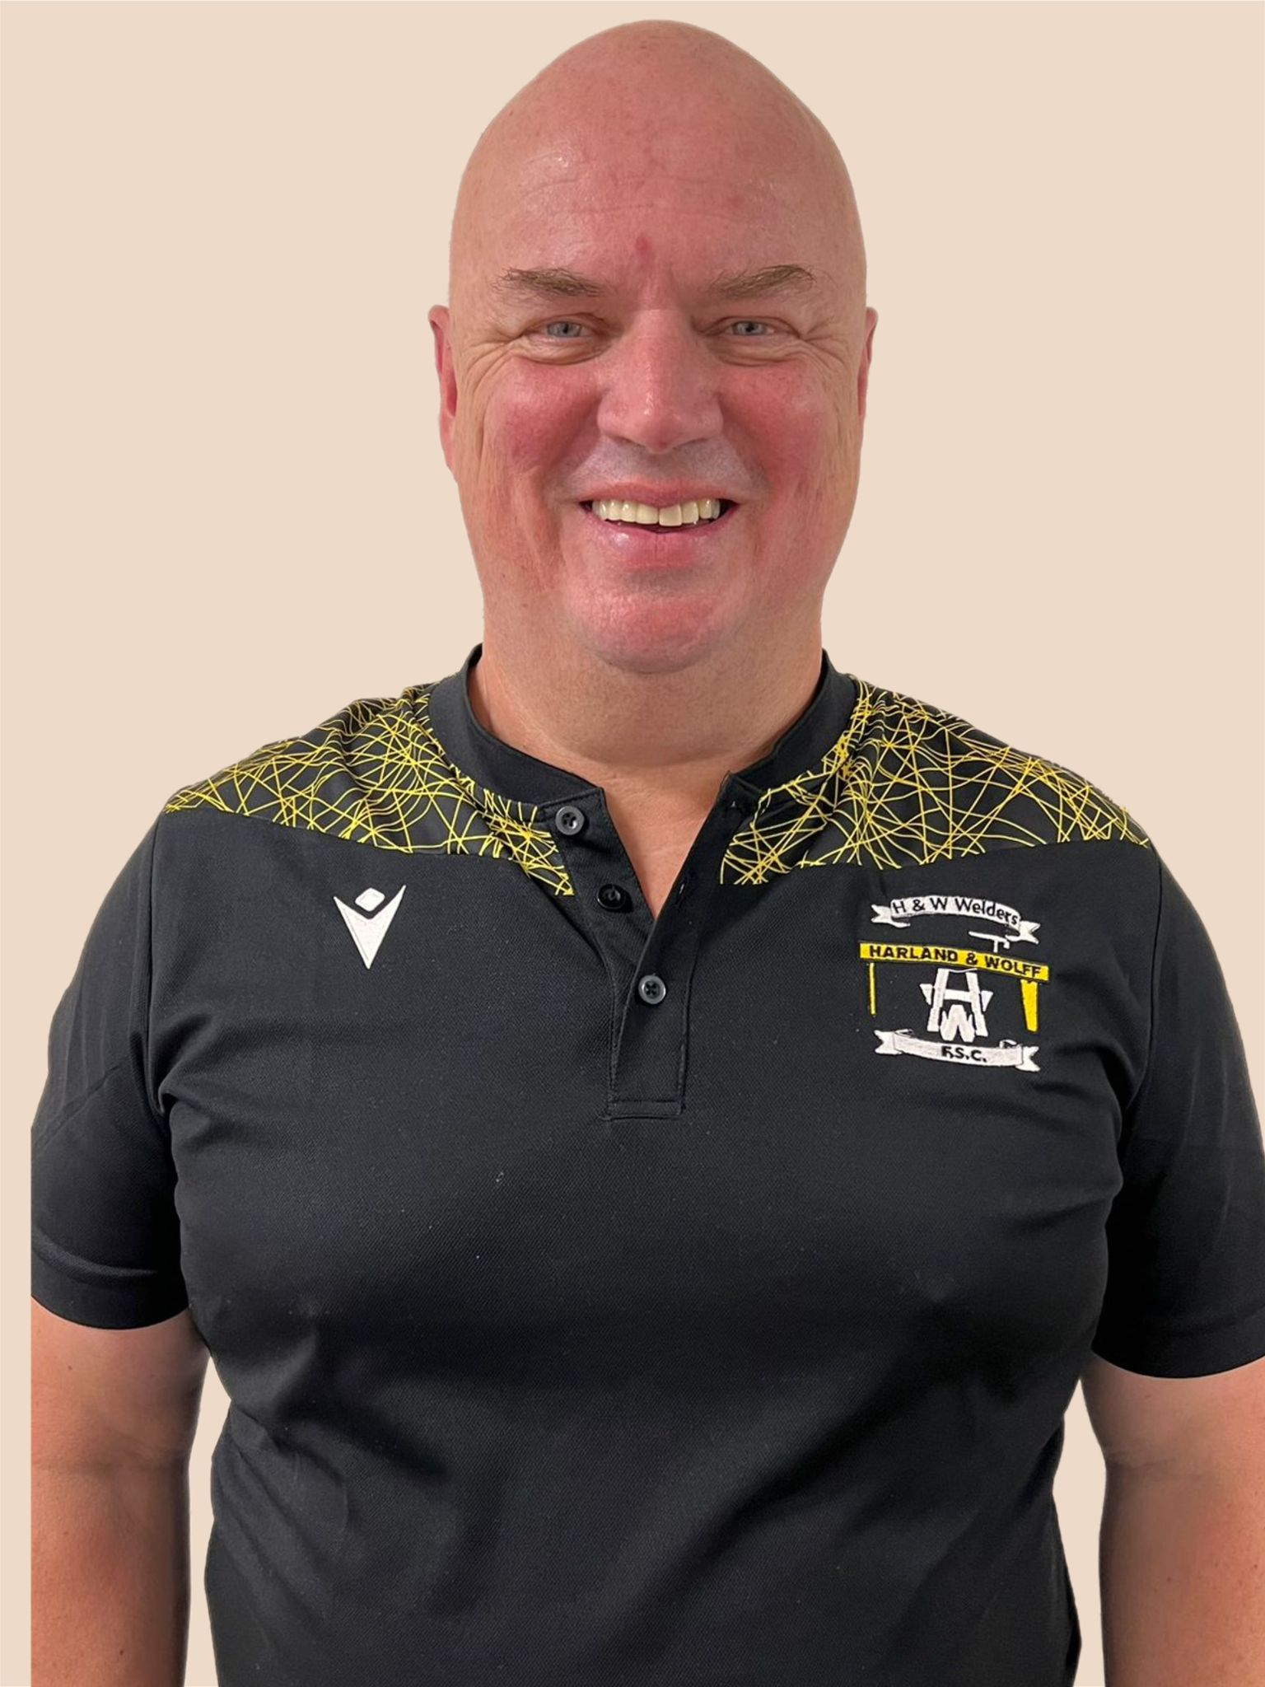
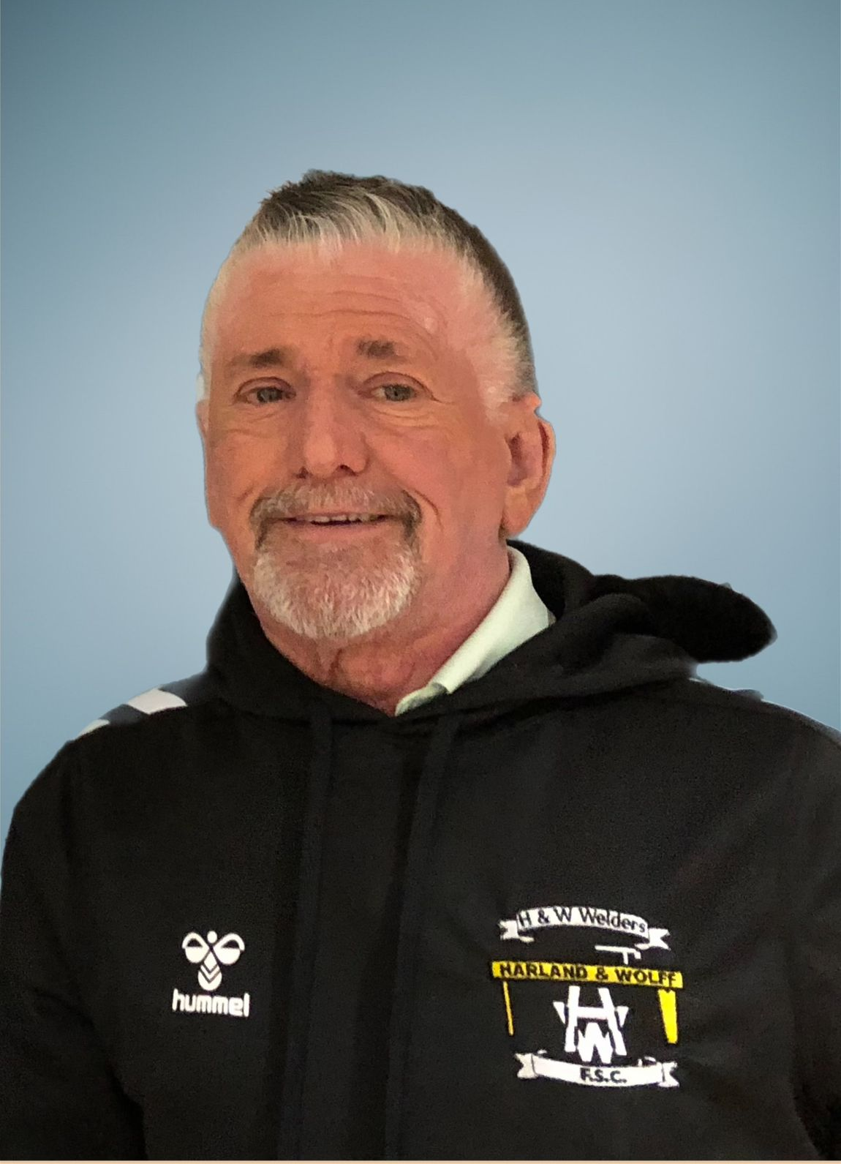
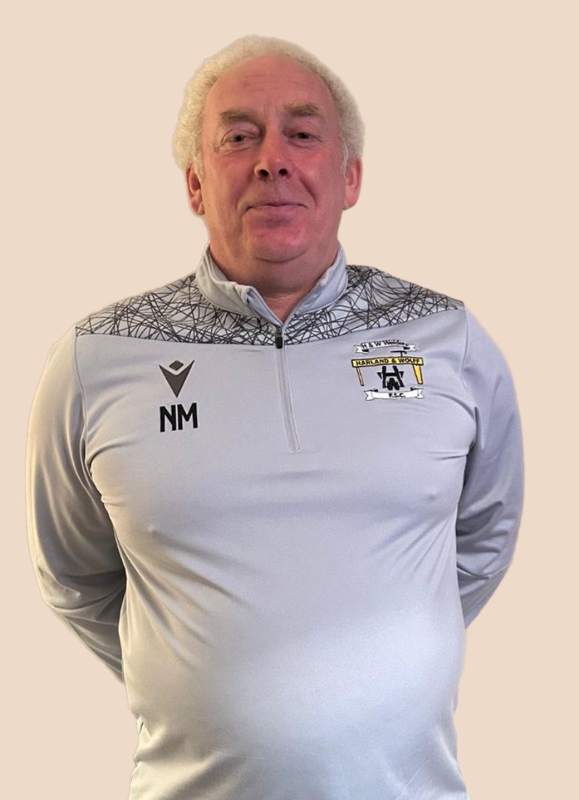
LEAD STAFF
Paul Kee
HEAD COACH
Raymond Alexander
DIRECTOR OF OPERATIONS
Noel Mitchell
HEAD OF DEVELOPMENT
Age 55 years
U.E.F.A. PRO LICENCE 2005
DIRECTOR OF YOUTH
DEVELOPMENT CARLISLE UNITED F.C. 9-19 YEARS
PERFORMANCE COACH IFA
FORMER NORTHERN IRELAND U17 MANAGER
Age 66 years
U.E.F.A.’A’ LICENCE 1999
U.E.F.A. PRO LICENCE 2007
UEFA Grassroots Coach of The Year 2004
Sport NI Coach of The Year 2004
Former IFA U15 Schoolboy International Manager
Age 55 years
U.E.F.A.’A’ LICENCE
CURRENT 1ST TEAM COACH
FORMER NI LADIES U17 HEAD COACH
FORMER IFA PERFORMANCE COACH

