Slide 1
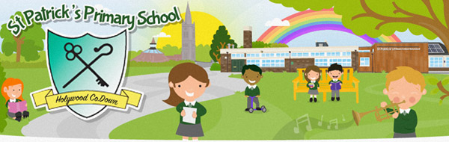
Primary 3
Curriculum Overview
2023/2024
Mrs Wilkinson

Slide 2
Daily routine
Register by 9:00 and daily Prayers
Phonics
Literacy
Outside play and healthy snack
Mental Maths & Maths
Lunch
RE , PE ,ICT, ABL, WAU
PE is every Tuesday morning.

Slide 3
Areas of learning
Language and Literacy
Mathematics and Numeracy
The Arts
Physical Education
ICT
World
Around
Us
PDMU/RE

Slide 4
Activity Based Learning
Learning through structured play and activities is still essential in Key Stage 1.
Literacy, Numeracy, World Around Us, STEM and ICT are developed through ABL.
A love of learning fostered through fun and engaging activities that suit a wide range of learners.
Children will learn to take risks, to explore, to test and to collaborate.
There are opportunities for differentiation in all activities.
Activities can include ICT games, construction tasks, drawing and writing tasks, reading, problem solving, collaborative games and so much more!

Slide 5

Literacy
Reading
Modelled, Shared, Guided, and Independent Reading
Related Activities linked to Oxford Reading and reading schemes include;
Sequencing words, sentences and stories
Labelling diagrams
Word decoding
Close Procedures
Questions and answers
Crosswords
Word searches (Nouns, verbs and adjectives)
Syllable work
All forms of Punctuation
Writing
Talking and Listening
Related activities include;
Development of Handwriting scheme
News Bites
Modelled writing of a variety of genres
Shared writing sessions
Linguistic Phonics Programme (spelling)
Exploration of sentence structure, punctuation and grammar linked to Shared Text
Independent writing in response to topic work
Word processing opportunities across the curriculum
Class, group and partner
discussions
Question and answer sessions
Reporting to different audiences
Role play (PDMU)
Drama
Assemblies
Connected Learning activities
Circle Time
WAU topics discussions
Please encourage your child to login to Bug Club on a daily basis.

Slide 6
Literacy
In P3 we encourage the children to write independently as much as possible, while providing them with many opportunities to develop their confidence and ability in this area. In P3 the children explore various forms of writing.
The more your child writes the more confident they will become.
At home, you can help build your child's confidence by offering many varied writing opportunities. These may include writing:
Thank you cards
Invitations,
Letters to relatives
Creating posters and comics
Shopping lists
Stories

Slide 7
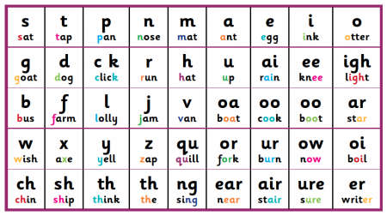
Phonics
Stage 1 - sounds represented by 1 letter.
Stage 2 - longer words each letter has its own sound.
Stage 3 - multi syllable words- each letter has its own sound.
Stage 4 - sound represented by more than 1 letter eg double letters, ff, ll, sh, ch, th etc
Stage 5 -same sound represented by different combinations of letters, e.g. now/about, look/your, boy/coin.
Stage 6 -A development of stage 5 words to include variations, e.g. “l/le” – loud and uncle
Spelling activities will be carried out in school and at home during the week.-e.g. word sorts, see it right, word searches, paper square clues.

Slide 8
How to help your child with Literacy at home.
Talking and Listening
Discussions, conversations, retelling stories
Reading
Read (model) a variety of texts – fiction/non-fiction, poetry
Talk about books – predict story/content/endings
Visit the library
Writing
Large arm movements – games, painting etc.
Cutting, using dough, drawing etc.
Write for fun – highlight differences between letters, words and sentences – make cards, posters, books etc.
Phonics
Encourage your child to sound out words for you
Practice simple word building and blending

Slide 9
Data Handling
Collect and present data in a variety of ways.
Number
Working with numbers to 100. To include place value and number recognition. Also addition, subtraction, word problems, mental arithmetic, money (up to £1) and fractions.
Mental Maths
To know which process or strategy to use when solving mathematical problems.
Please see handout with different mental maths strategies that we use.
Numeracy
Measures
Time, Length, Area, Weight, Capacity and Volume. Both practical investigation and written recording.
Learning key facts and number bonds. Days of the week and months of the year.
Shape and Space
Properties of 2D and 3D shapes, symmetry, position, movement and direction and using programmable devices.

Slide 10
Numeracy
Counting on/
Counting back
Re-ordering
Partitioning
The
Seven Strategies for
Mental Calculation
Rounding
And
Adjusting
Using
Equivalence
Inverse Operations
Using Factors

Slide 11

World Around Us
Increasing understanding & observational skills.
Developing skills of research
Developing thinking skills and personal capabilities
Range of topics covered: Celebrations, Superheroes and Under The Sea.
Children are actively engaged in a topic and will do research in class and at home
Topic work is reinforced through ABL activities and a series of planned Educational Visits

Slide 12

Religion
Children will follow the Grow in Love series:
Interactive Songs and stories
Bible Stories
Prayers
Preparation for First Confession

Slide 13

Homework
Homework is given on Monday and to be returned by Friday
Grow in Love homework is given on Thursday, to be returned by Friday
Maths and spellings learning each week to be completed in their book
It is important that all homework be completed and sent in on time

Slide 14


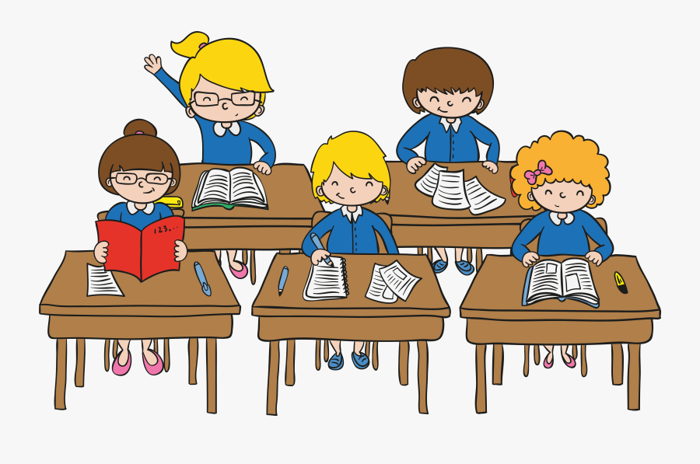
Other areas
Behaviour
High expectations are held for behaviour, particularly attention and listening
Punctuality and full attendance is extremely important
Positive reinforcement strategies are key
We use Dojo points and Top 30 reward system to help reinforce positive behaviour and children have lots of opportunities to get stickers and prizes., with friendship and merit awards given at assembly
Open dialogue between home and school is essential.
Special Needs
Children identified as requiring some level of support may have a Pre-Code Targeted plan or an IEP. SEN support is provided primarily in class, but some children may also benefit from additional support in the Rainbow Room.
Assessment
Continuous assessment takes place in class through our weekly assessments, teacher observations and regular summative assessments at the end of topics.
Progress in Maths / Progress in English assessments take place at the end of the year, beginning with P3.

Slide 15
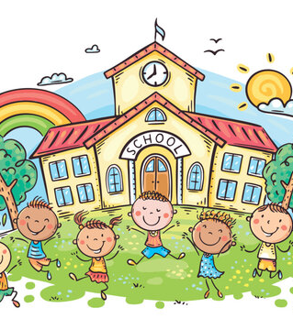
Thankyou

